Slide 1
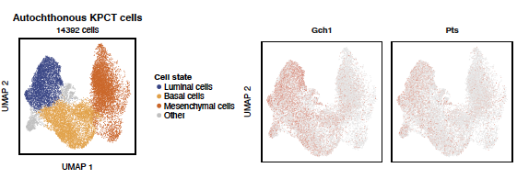

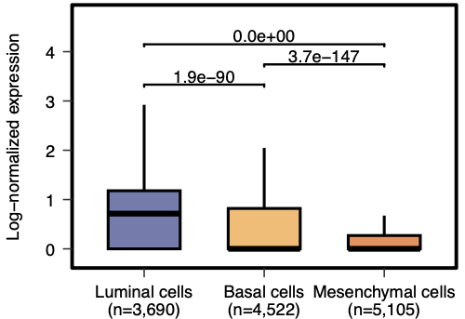
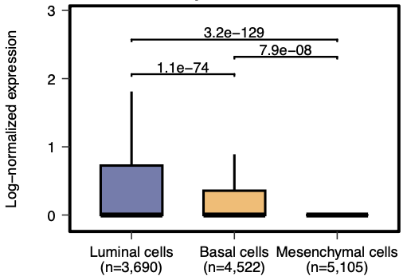
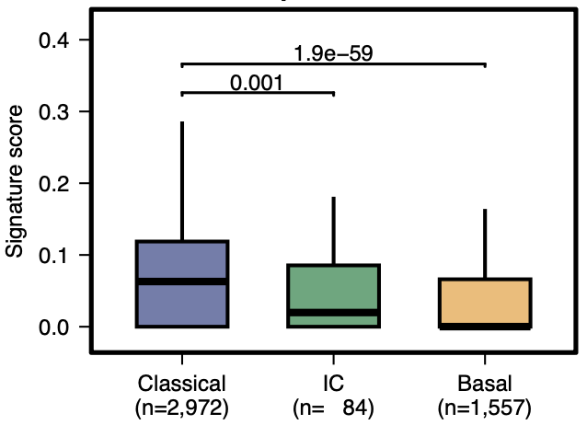
Extended data Fig. 6
a
b
PDAC mouse
Gch1 expression
c
PDAC mouse
Pts expression
d
Human primary PDAC scRNA-seq (Cohort 2 –
Lin et al 2020; PMID 32988401)

